Slide 1
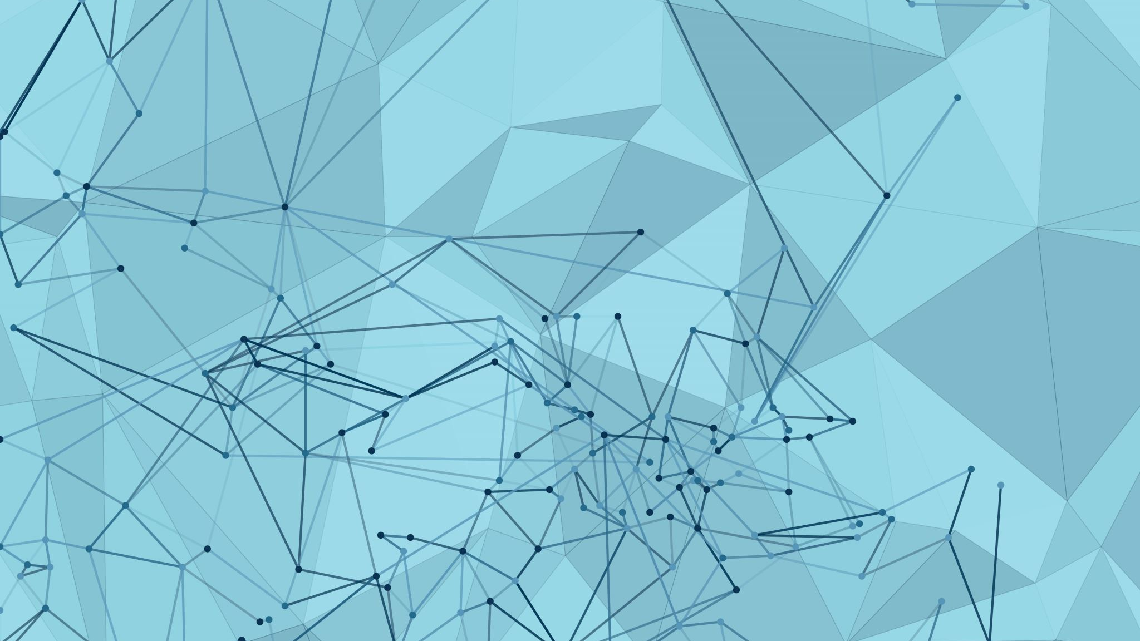
Computational Neuroscience
section 1

Slide 2
ML Vs Deep Learning
Deep learning is a subset of Machine Learning (ML) in Artificial Intelligence (AI). Deep learning uses neural networks to process data such as images, videos, or text. Deep learning models are built with layers of artificial neurons called artificial neural networks (ANN). These networks are designed to process information and learn patterns from vast amounts of data.

Slide 3
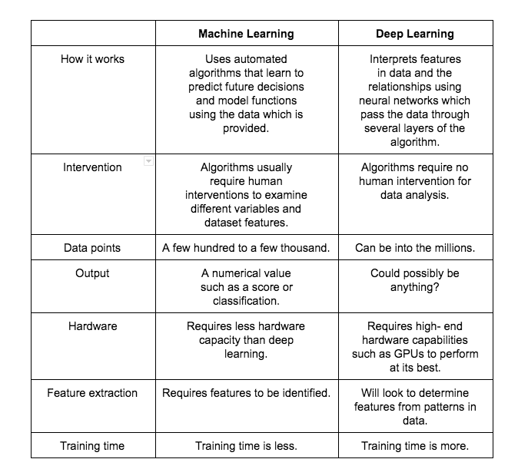
ML Vs Deep Learning

Slide 4
ML Vs Deep Learning
Let us do a recap:
Machine learning uses algorithms to parse data, learn from that data, and then make informed decisions based on what it has learned.
Deep learning is a subset of machine learning. It organizes algorithms in layers to create an artificial neural network that can learn and make intelligent decisions without any outside intervention and by finding patterns in the data provided.

Slide 5
ML Vs Deep Learning
Deep learning uses a massive amount of data to learn. With the phenomenal increase in the amount of data we collect, in the very near future, we hope that deep learning will be able to provide new opportunities and innovations.

Slide 6
Why PyTorch
Python-like coding.
Dynamic graph.
Easy and quick editing.
Good documentation and community support.
Open source.
Plenty of projects out there using PyTorch.

Slide 7
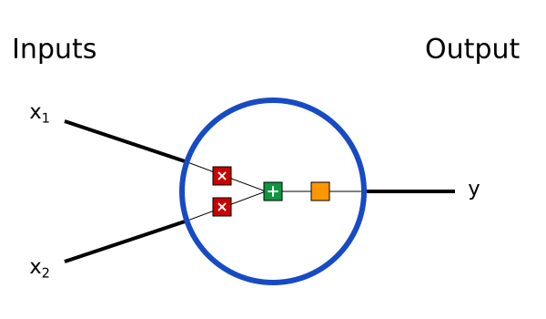
how neural networks work while implementing one from scratch in Python.
1. Building Blocks: Neurons
First, we have to talk about neurons, the basic unit of a neural network. A neuron takes inputs, does some math with them, and produces one output. Here’s what a 2-input neuron looks like:

Slide 8

how neural networks work while implementing one from scratch in Python.
In the drawing above, 3 things are happening:
1- each input is multiplied by a weight: neural networks work while implementing one from scratch in Python.
2- all the weighted inputs are added together with a bias b
Finally, the sum is passed through an activation function:

Slide 9
Activation Functions
activation functions are one of the key concepts of Deep Learning.
The goal of an activation function is to make the network more stable and better at generalizing

Slide 10
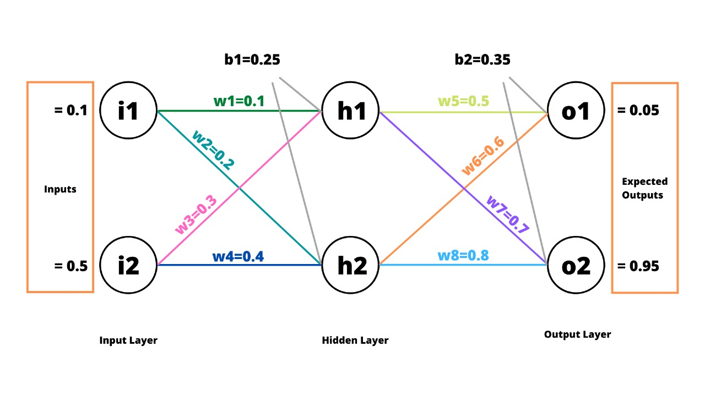
Build simple Neural Network

Slide 11
Thanks

